Slide 1
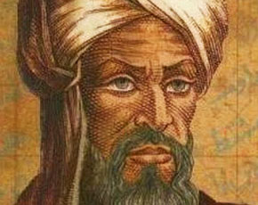
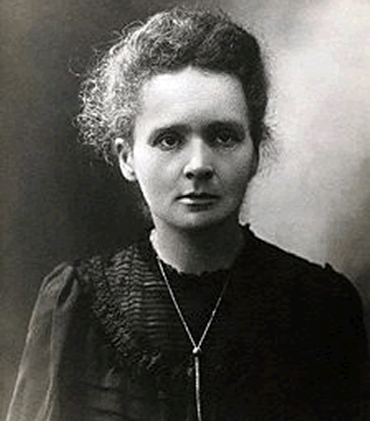
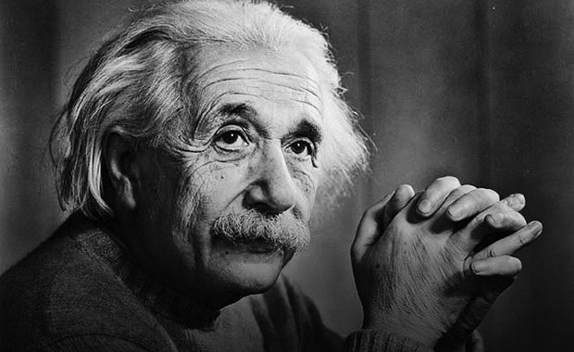
Grade Six Unit 9
Student’s Book Page 71
Famous people

Slide 2
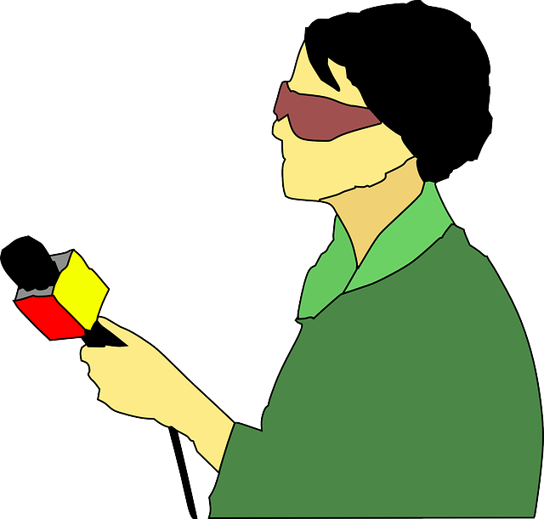



Today the interview is about what you want to study in the future after school.

Slide 3

a meeting in which someone asks another one questions for a job or a programme
interview

Slide 4



What do you want to study at university?

Slide 5
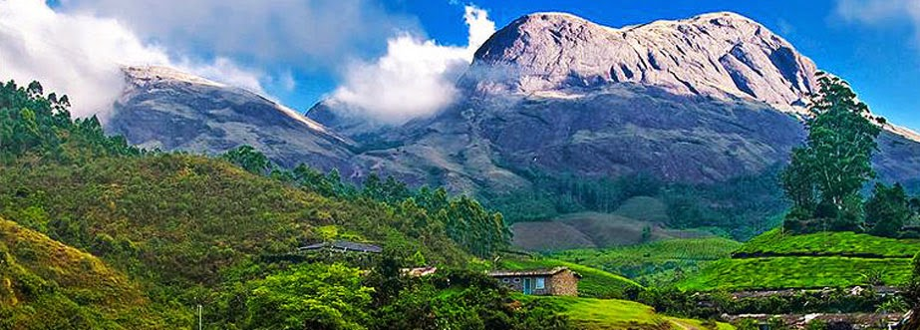
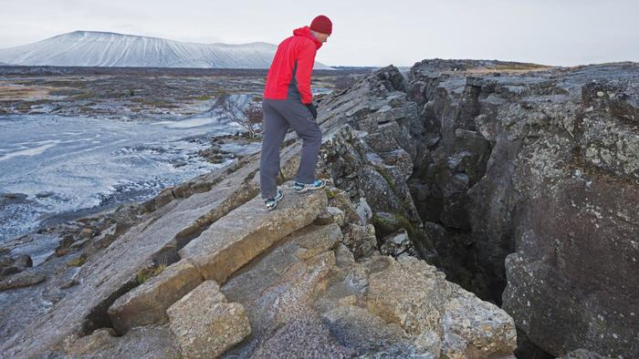
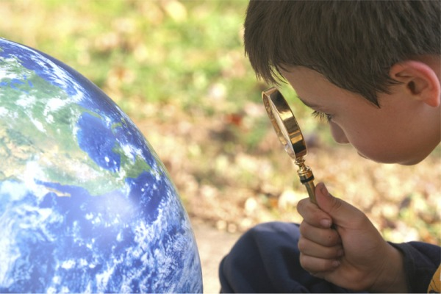
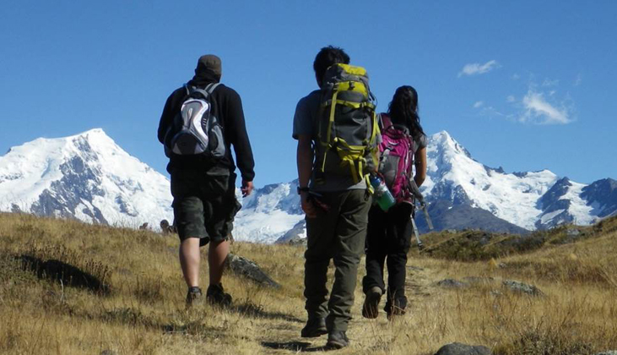
Geography is the study of the earth.

Slide 6



Slide 7



Slide 8



Think of another subject you want to study when you leave school.

Slide 9


I want to study algebra.

Slide 10


What is algebra?

Slide 11
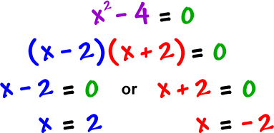
Algebra is maths
which uses
letters & signs.

Slide 12
Look at the picture and guess the word
New Vocabulary

Slide 13

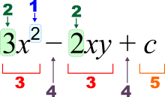



algebra
geography
interview

Slide 14
Student’s Book
page 71

Slide 15
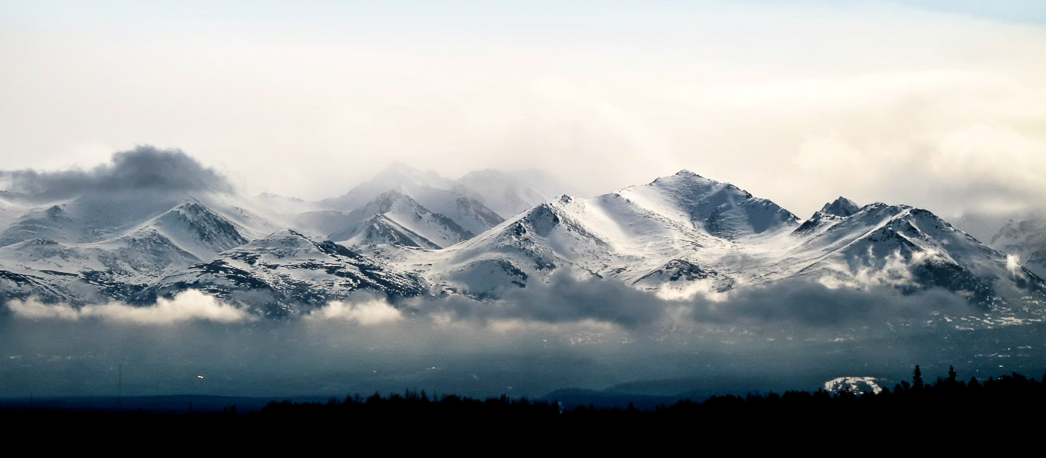

Slide 16


algebra
X = 2
3(2+21)=69

Slide 17

During Listening
( Listen then answer)

Slide 18

a) Collecting stamps is a nice hobby.
b) Al Khawarizmi was a great scientist.
c) Studying geography is fun.

Slide 19





Slide 20

After
Listening

Slide 21


Slide 22


Slide 23
